Slide 1
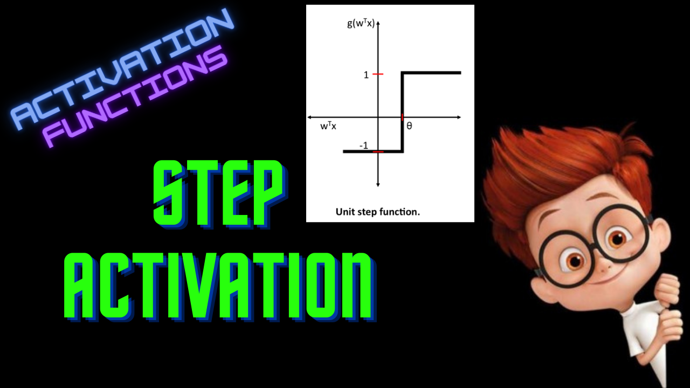

Slide 2
Step Function
ML For Nerds

Slide 3
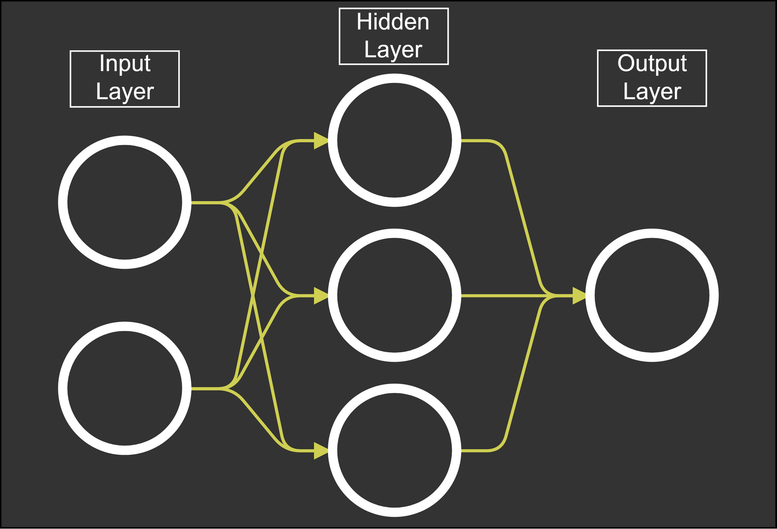


Binary Classification
Inputs: [1,0]
Weights-1: [[1,2],
[2,3],
[3,4]]
Weights-2: [1,2,3]

Slide 4
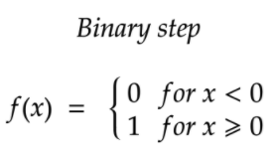
Binary Classification
1
1
2
14
0
3

Slide 5
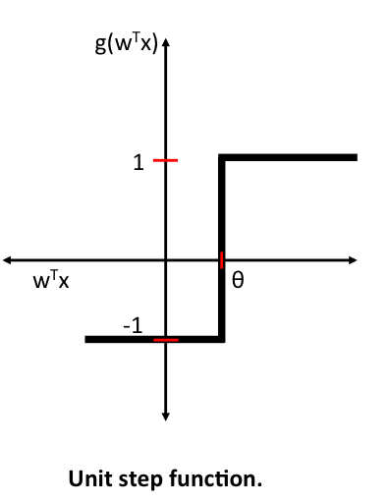
Step Activation

Slide 6
Drawbacks
Derivative is 0
Hard threshold
Only for binary classification

Slide 7
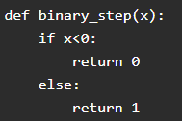

Python code

